Slide 1
Start
Small
Grow
As
You Need
Spot the
Object
Objects
Everywhere
What kind of
Thing
?
What if
There’s
Nothing?
There can
Be only
Five !

Slide 2
Start
Small
Grow
As
You Need
Spot the
Object
Objects
Everywhere
What kind of
Thing
?
What if
There’s
Nothing?
There can
Be only
Five !

Slide 3
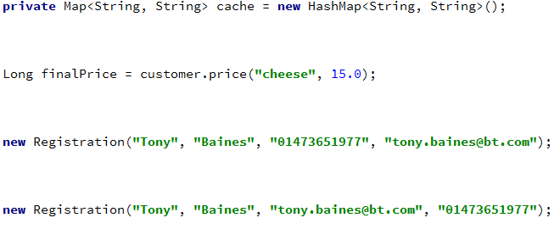
Notes:
Java, Ruby, C#, C++
Object Oriented languages
Some more than others
‘Primitive’ objects
String, Numeric, Boolean
Domain concepts
Names, Money, Validity

Slide 4
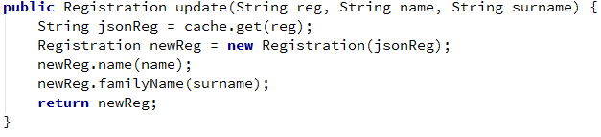
Notes:
The cache seems to be holding a serialised copy of the registration
The ‘reg’ String parameter looks like an ID of some sort

Slide 5
Notes:
The idea of a family name and surname are roughly equivalent, are they the same in this code?
Easy to transpose name and surname parameters

Slide 6
We write more logic
Where does it belong?
Duplicated, scattered over the code base?
Utility classes – poor encapsulation and easily overlooked

Slide 7
Start
Small
Grow
As
You Need
Spot the
Object
Objects
Everywhere
What kind of
Thing
?
What if
There’s
Nothing?
There can
Be only
Five !

Slide 8
Micro-types
aka Abstract Data Types, Tiny Types
Data and operations on that data belong together
So, invent your own types for your domain

Slide 9
Start
Small
Grow
As
You Need
Spot the
Object
Objects
Everywhere
What kind of
Thing
?
What if
There’s
Nothing?
There can
Be only
Five !

Slide 10
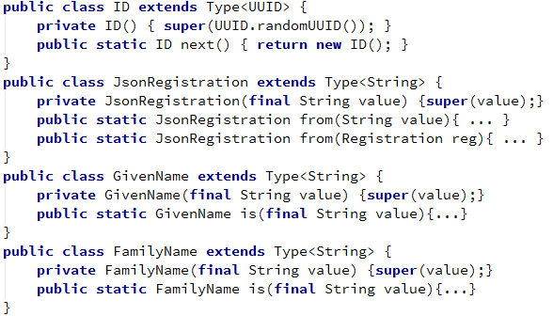
Notes:
An abstract class provides the common features (we’ll come back to that)
No setters (immutable)

Slide 11
Notes:
Each Type has one or more factory methods (more on that later)

Slide 12
Notes:
… and a private constructor that just delegates to the super class

Slide 13
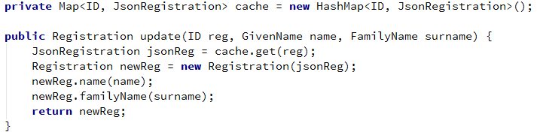
Notes:
With these new types defined, our code becomes more obvious

Slide 14
Notes:
The contents of the cache become clear

Slide 15
Notes:
Any confusion about the order of parameters disappears

Slide 16
Start
Small
Grow
As
You Need
Spot the
Object
Objects
Everywhere
What kind of
Thing
?
What if
There’s
Nothing?
There can
Be only
Five !

Slide 17
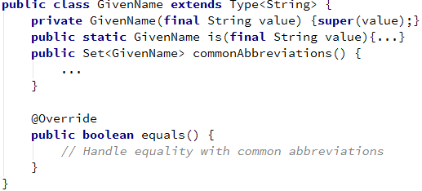
Notes:
A GivenName type can be exactly what you need it to be
Here we’ve introduced the idea of common alternatives, and extended the concept of equality

Slide 18
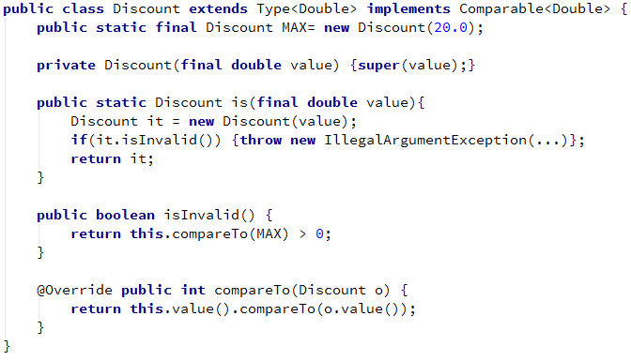
Notes:
This is a more complicated example

Slide 19
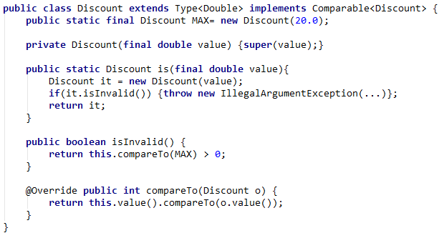
Notes:
more domain logic – the concept of validity

Slide 20
Notes:
Here we’ve introduced
more domain logic – the concept of validity
A singleton static value representing the maximum discount
The idea of comparison – collections of Discounts can also be sorted

Slide 21
Notes:
A singleton static value representing the maximum discount

Slide 22
Start
Small
Grow
As
You Need
Spot the
Object
Objects
Everywhere
What kind of
Thing
?
What if
There’s
Nothing?
There can
Be only
Five !

Slide 23
java.lang.NullPointerException
at c.b.i.p.b.s.TEPv1EventsTranslator.processToCalls(TEPv1EventsTranslator.java:246)
at c.b.i.p.b.s.TEPv1EventsTranslator.getCallUpdates(TEPv1EventsTranslator.java:232)
at c.b.i.p.b.s.TEPv1EventsTranslator.processTrsEventType(TEPv1EventsTranslator.java:207)
at c.b.i.p.b.s.TEPv1EventsTranslator.translateFrom(TEPv1EventsTranslator.java:165)
at c.b.i.p.b.s.TEPv1EventsTranslator.translateFrom(TEPv1EventsTranslator.java:48)
at c.b.i.p.b.s.SessionManagerEventsControl$2$1.run(SessionManagerEventsControl.java:197)
at c.b.i.p.b.s.SessionManagerEventsControl$2.onEvent(SessionManagerEventsControl.java:220)
at c.b.u.c.e.subscription.messaging.RemoteEventsListenerWrapper.onMessage(RemoteEventsListenerWrapper.java:38)
at c.b.u.c.e.messaging.hazelcast.HazelcastMessageListener.onMessage(HazelcastMessageListener.java:31)
at com.hazelcast.client.impl.MessageListenerManager.notifyMessageListeners(MessageListenerManager.java:67)
at com.hazelcast.client.impl.ListenerManager.customRun(ListenerManager.java:84)
at com.hazelcast.client.ClientRunnable.run(ClientRunnable.java:30)
at java.lang.Thread.run(Thread.java:722)

Slide 24
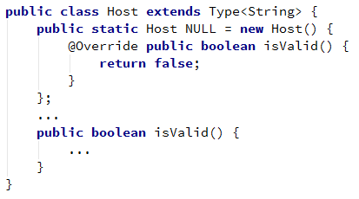
Notes:
The Null Object pattern helps avoid null references
Instead of assigning (or defaulting) the ‘host’ to null
Define an object to represent the idea and behaviour of a Null Host

Slide 25
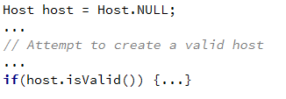
Notes:
Can be used later in the code without the need for null-checks or the risk of NPE

Slide 26
Start
Small
Grow
As
You Need
Spot the
Object
Objects
Everywhere
What kind of
Thing
?
What if
There’s
Nothing?
There can
Be only
Five !

Slide 27
Collections Are Objects Too
Take the example of a skydiving course
Each session can only hold 5 attendees
We know that we’ll want to add and remove attendees

Slide 28
Notes:
Subclassing is attractive because of its simplicity

Slide 29
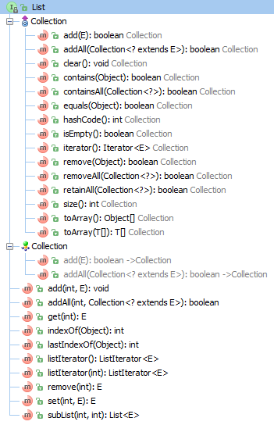
Notes:
… but the downside is that the API may be far broader than your domain needs

Slide 30
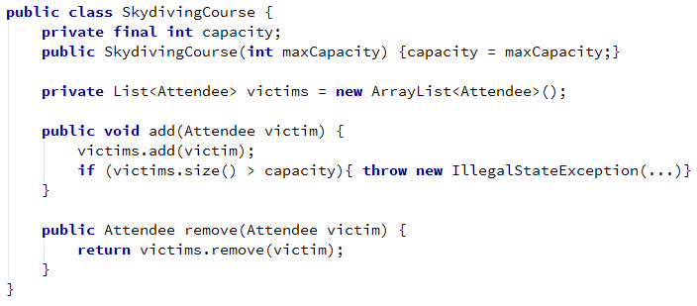
Notes:
Delegation is a little more work, but it keeps the API clean

Slide 31
Start
Small
Grow
As
You Need
Spot the
Object
Objects
Everywhere
What kind of
Thing
?
What if
There’s
Nothing?
There can
Be only
Five !

Slide 32
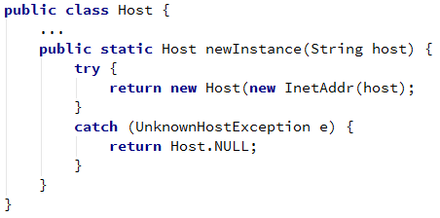
Factory methods
More flexible than constructors
Notes:
A constructor can succeed or throw an exception
Factory methods can be more intelligent
Here we return the Null Object instance if a bad address is passed in
Might also attempt different strategies for understanding the String passed in

Slide 33
Things to think about
equals() and hashCode()
Often used with Collections
Boundaries
Converting to and from primitives
Nulls
What does a null represent?
toString()
Especially when migrating from String
Override in the least surprising way
Serialisation, Comparable

Slide 34
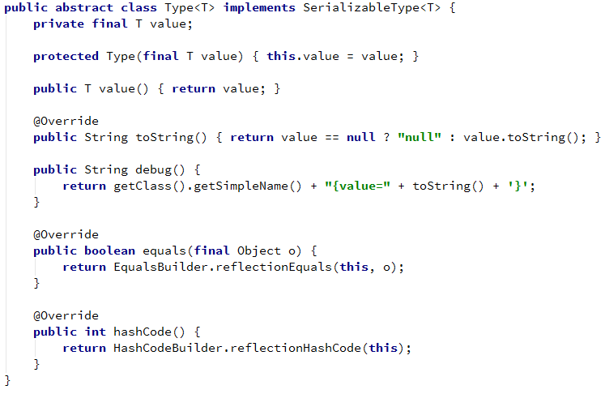

Slide 35
When to add micro-types
Earlier is better
Refactoring from a micro-type is easy later
Changing the type from String to FirstName later is hard
Behaviour naturally accumulates when the type exists
Less scattered code to draw together later

Slide 36
Start
Small
Grow
As
You Need
Spot the
Object
Objects
Everywhere
What kind of
Thing
?
What if
There’s
Nothing?
There can
Be only
Five !

